Slide 1
Maximum Flows
CONTENTS
Introduction to Maximum Flows (Section 6.1)
Introduction to Minimum Cuts (Section 6.1)
Applications of Maximum Flows (Section 6.2)
Flows and Cuts (Section 6.3)
Generic Augmenting Path Algorithm (Section 6.4)
Max-Flow Min-Cut Theorem (Section 6.5)
Capacity Scaling Algorithm (Section 7.3)
Generic Preflow-Push Algorithm (Section 7.6)
Specific Preflow-Push Algorithms (Section 7.8)

Slide 2
Problem Definition
Maximum Flow Problem: Given a directed network G with arc capacities given by u_{ij}’s, determine the maximum amount of flow that can be sent from a source node s to a sink node t.
₂₀
₂
₄
₁₀
₃₀
s
₁₅
t
₁
₃₅
₄₀
₆
₂₅
₂₀
₃
₃₅
₅
Decision Variables: Flow x_{ij} on arc (i, j), and the flow v entering the sink node.

Slide 3
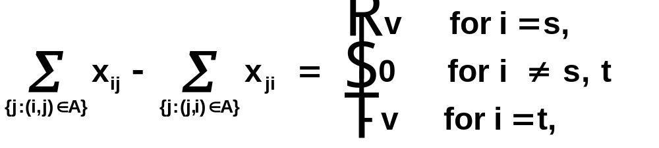
A Linear Programming Problem
The maximum flow problem can be formulated as the following linear programming problem:
Maximize v
subject to
0 ≤ x_{ij} ≤ u_{ij} for every arc (i, j) ∈ A

Slide 4
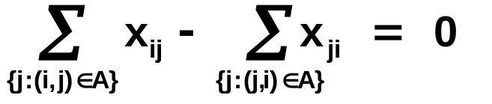
An Alternate Formulation
The maximum flow problem can also be conceived of as the following minimum cost flow problem:
Minimize -x_{ts}
subject to
l_{ij} ≤ x_{ij} ≤ u_{ij} for every arc (i, j) ∈ A
₂
₂₀
₄
₁₀
₃₀
s
₁₅
t
₁
₃₅
₄₀
₆
₂₅
₂₅
₃
₃₅
₅
Cost = -1,
Capacity = ∞

Slide 5
Assumptions
All arc capacities u_{ij}'s are integer and U is the largest magnitudes of arc capacities.
The network is directed.
  To satisfy this assumption, replace each undirected arc (i, j) with capacity u_{ij} by two directed arc (i, j) and (j, i) with capacity u_{ij}.

Slide 6

Minimum Cut Problem
A cut is a (minimal) set of arcs whose deletion from G disconnects the network (into two parts S and ).
An s-t cut is a cut that disconnects nodes s and t.
We denote an s-t cut as [S, ].
₂₀
₂
₄
₁₀
₁₅
₃₀
s
₃₅
t
₁
₄₀
₆
₂₅
₂₀
₃
₃₅
₅

Slide 7
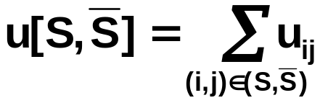
Minimum Cut Problem (contd.)
₂₀
₂
₄
₁₀
₁₅
₃₀
s
₃₅
t
₁
₄₀
₆
₂₅
₂₀
₃
₃₅
₅
(S, ): Set of forward arcs in the cut [S, ]
( , S): Set of backward arcs in the cut [S, ]
u[S, ] : Capacity of the cut [S, ] defined as

Slide 8
Assumptions
1. Network is directed.
  How to satisfy this condition?
2. All arc capacities are nonnegative integers. Let U denote the largest arc capacity.
3. The network does not contain an uncapacitated (that is, infinite capacity) directed path from node s to node t.
  How to identify such a possibility?
4. Whenever arc (i, j) is in A, (j, i) is also in A.
  How to satisfy this condition?
5. The network does not contain parallel arcs.
  How to eliminate this possibility?

Slide 9
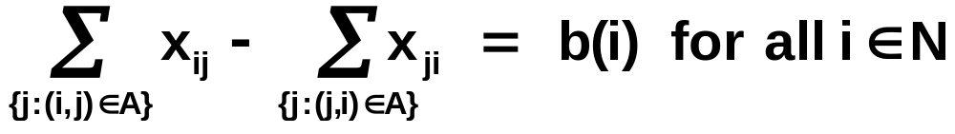
Feasible Flow Problem
In a sea-port network, merchandize is available at some sea-ports and desired at other ports. We know the supplies/ demands at various ports. Routes too have capacities. Is it possible to satisfy the demands by available supplies?
Find a flow x satisfying the following constraints:
0 ≤ x_{ij} ≤ u_{ij} for every arc (i, j) ∈ A.
The feasible flow problem is a feasibility version of the minimum cost flow problem.

Slide 10
Feasible Flow Problem (contd.)
Network G:
Network G′:
Supply
nodes
Supply
nodes
Demand
nodes
Demand
nodes
5
b(5)<0
1
4
5
b(1)>0
1
4
b(1)
-b(5)
3
3
s
b(2)
2
t
b(2)>0
2
7
7
-b(6)
b(8)
b(8)>0
8
8
9
6
9
6
b(6)<0
If the network G possesses a feasible flow, then the network G’ possesses a maximum flow that saturates all arcs emanating from the source node.
If the network G’ possesses a maximum flow saturating all arcs emanating from the source node, then the network G possesses a feasible flow.

Slide 11
Dining Problem
Several families go out to dinner together. They would like to sit at tables so that no two members of the same family sit at the same table. How to do it? Let the i^{th} family has a(i) members and j^{th} table has a seating capacity of b(j).
Family
nodes
u_{ij} =1
Table
nodes
a(1)
1
1’
-b(1)
a(2)
2
2’
-b(2)
a(3)
3
3’
-b(3)
a(4)
4
The dining problem has a feasible solution if and only if the above network possesses a feasible solution.

Slide 12
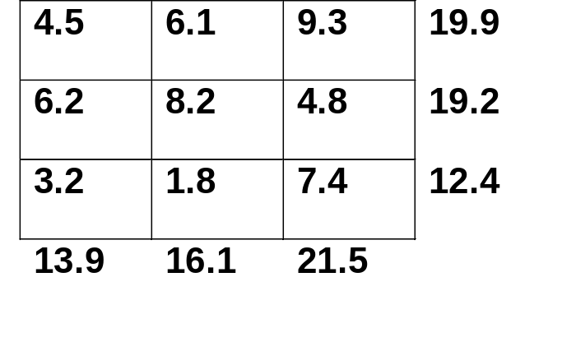
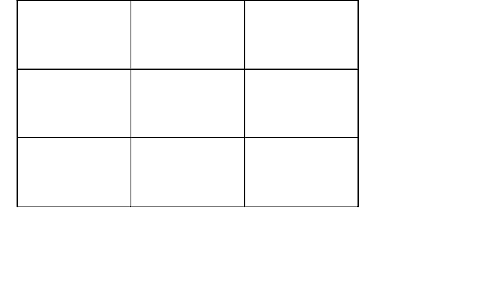
Matrix Rounding Problem
Given a p x q matrix of real numbers D = {d_{ij}} with row sums a_{i}’s and column sums b_{j}’s, round (up or down) the matrix elements d_{ij}’s, a_{i}’s, and b_{j}’s so that the matrix is consistent:
  Row sums of the rounded elements equals the rounded row sums
  Column sums of the rounded elements equals the rounded column sums
Determine such a consistent rounding if it exists.

Slide 13
Matrix Rounding Problem (contd.)
Maximum Flow Formulation with Lower and Upper Bounds:
1
[4,5]
1’
[6,7]
[13,14]
[19,20]
[9,10]
[6,7]
[16,17]
t
s
2
2’
[19,20]
[8,9]
[4,5]
[3,4]
[21,22]
[12,13]
[1,2]
3
3’
[7,8]
There is a one-to-one correspondence between consistent roundings and feasible integer flows in the above network.

Slide 14
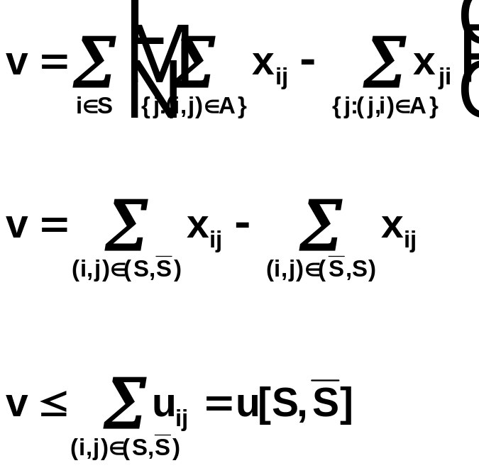
Flow Across an s-t Cut
Flow across a cut [S, ] is defined as flow taking place on forward arcs minus the flow on backward arcs.

Slide 15
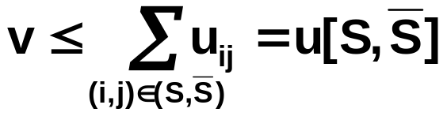
Properties of Flows and Cuts
PROPERTY 1. The value of any flow is less than or equal to the capacity of any cut in the network.
PROPERTY 2. Maximum flow value ≤ minimum cut capacity.
PROPERTY 3. If for some flow x, its value equals the capacity of some s-t cut [S, ], then x must be a maximum flow
and [S, ] must be a minimum cut.
Is maximum flow value = minimum cut capacity ?
Yes! and we will prove it later.

Slide 16
Residual Network
Plays a central role in the development of maximum flow algorithms.
Defined with respect to a flow x.
Denotes how much flow can be sent on arcs with respect to a flow x.
(x_{ij}, u_{ij})
r_{ij}
i
j
i
j
2
2
[5,5]
3
5
[3,4]
1
1
2
1
4
1
[2,3]
4
[2,2]
[0,1]
2
1
3
3

Slide 17
The Generic Augmenting Path Algorithm
Any directed path from node s to node t in the residual network is an augmenting path.
The generic augmenting path augments flow along augmenting paths until there are no augmenting paths.
₂
₄
₄
₁
₃
₄
₂
₂
₃

Slide 18
The Generic Augmenting Path Algorithms (contd.)
algorithm augmenting path;
begin
x := 0;
while G(x) contain an augmenting path do
begin
identify an augmenting path P;
δ := min {r_{ij} : (i, j) ∈ P};
augment δ units along P and update G(x);
end;
end;
We can identify an augmenting path in O(m) time using a search algorithm.
The algorithm performs at most nU iterations.
The algorithm runs in O(nmU) time.

Slide 19
Correctness of the Algorithm
Let the algorithm terminate with flow x*. Let S denote the set of nodes which are reachable from the source node. Then
  each forward arc in the cut [S, ] must have x_{ij} = u_{ij}
  each backward arc in the cut [S, ] must have x_{ij} = 0
Flow x* is a maximum flow and [S, ] is a minimum cut.
full
2
5
full
3
t
s
6
7
empty
8
1
empty
9

Slide 20
Some Theorems
THEOREM 1 (Max-Flow Min-Cut Theorem). The maximum value of the flow from a source node s to a sink node t in a capacitated network equals the minimum capacity among all s-t cuts.
THEOREM 2 (Augmenting Path Theorem). A flow x* is a maximum flow if and only if the residual network G(x*) contains no augmenting paths.
THEOREM 3 (Integrality Theorem). If all arc capacities are integer, then the maximum flow problem has an integer maximum flow.

Slide 21
Drawbacks of Augmenting Path Algorithms
₂
10⁶
10⁶
₁
1
₄
10⁶
10⁶
₃
The algorithm may perform exponentially many iterations.
If arc capacities are irrational, then the algorithm might not terminate and the value it might converge to might be incorrect.
The algorithm does not make use of computations of the previous iterations.

Slide 22
Improved Augmenting Path Algorithms
SHORTEST AUGMENTING PATH ALGORITHM
  Always augments flows along the shortest augmenting path in G(x), that is, containing the least number of arcs.
  A breadth-first search of G(x) from node s will determine the shortest augmenting path in G(x).
  The shortest augmenting path algorithm performs at most nm augmentations and can be implemented to run in O(n²m) time.
CAPACITY SCALING ALGORITHM
  Proceeds by augmenting flows along paths of sufficiently large residual capacity.
  The capacity scaling algorithm performs at most
  2m(log U) augmentations and can be implemented in O(nm log U) time.

Slide 23
Capacity Scaling Algorithm
Is a specific implementation of the generic augmenting path algorithm.
Maintains a parameter Δ and performs a number of scaling phases.
In the Δ-scaling phase, it augments flow along an augmenting path with residual capacity at least Δ.
When there is no such path, it replaces Δ by Δ/2 and repeats the above process.
The algorithm terminates at the end of the Δ-scaling phase with Δ = 1.
The algorithm performs at most 2m augmentations in a scaling phase and O(m log U) overall.

Slide 24
Example of Capacity Scaling Algorithm
Δ-residual Network: A subgraph of G(x) containing only those arcs whose residual capacity is at least Δ.
₄₀
₂
₄
₁₀
₃₀
s
₁₅
t
₁
₃₅
₄₀
₆
₂₅
₂₅
₃
₃₅
₅

Slide 25
Capacity Scaling Algorithm
algorithm capacity-scaling;
begin
x: = 0;
Δ : = 2^{⎣log U⎦};
while Δ ≥ 1 do
begin
while G(x, Δ) contains an augmenting path do
begin {Δ-scaling phase}
identify an augmenting path in G(x, Δ);
λ : = min{r_{ij}: (i, j) ∈ P};
augment λ units along P and update G(x, Δ);
end; {Δ-scaling phase}
Δ : = Δ /2;
end;
end;

Slide 26
Complexity Analysis of Capacity Scaling Algorithm
Consider the end of the 2Δ-scaling phase.
Let S denote the set of nodes which are reachable from the source node in G(x, 2Δ).
Each forward arc (i, j) in the cut [S, ] in G(x) has r_{ij} < 2Δ.
S
r_{ij} < 2Δ
5
2
r_{ij} < 2Δ
6
3
t
s
r_{ij} < 2Δ
7
8
1
9
r_{ij} < 2Δ

Slide 27
Complexity Analysis (contd.)
When the 2Δ-scaling phase ends, we can send at most 2mΔ units of additional flow.
In the Δ-scaling phase, each augmentation sends at least Δ units of flow.
The Δ-scaling phase will perform at most 2m augmentations.
The algorithm will perform at most O(m log U) augmentations.
The capacity scaling algorithm runs in O(m² log U) time.
Capacity scaling algorithm can be implemented in O(nm log U) time.

Slide 28
Basic Features of Scaling Algorithms
Decompose the original problem into a sequence of approximate problems P₁, P₂, ..., P_{K}, with each successive problem less approximate than the preceding problem.
The problem P₁ is trivially solvable.
The problem P_{K} is the original problem.
P_{K+1} is solved by reoptimizing the optimal solution of P_{K}.
Works well when data are integral and reoptimization is much faster than solving the problem afresh.

Slide 29
Drawbacks of Augmenting Path Algorithms
11
1
1
12
1
13
1
1
1
14
1
1
1
15
1
∞
∞
∞
∞
∞
∞
∞
∞
∞
16
21
1
2
3
3
5
6
7
8
9
10
1
1
1
1
17
1
1
1
18
1
1
1
19
20

Slide 30
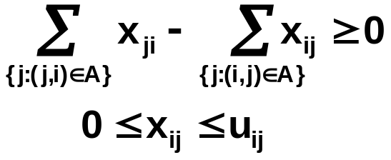
Preflow-Push Algorithms
Substantially different than augmenting path algorithms.
Do not maintain mass balance constraints.
Are currently the fastest maximum flow algorithms (theoretically, as well empirically).
Preflow-push algorithms maintain a preflow instead of a flow.
In a preflow x, inflow into any node is greater than or equal to its outflow:

Slide 31
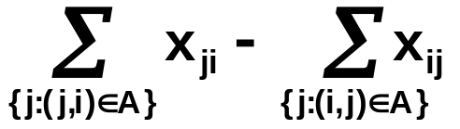
Example of a Preflow
₀
₁
₅
₂
₄
₁₀
₂
s
₀
t
₁
₅
₂
₆
₂₀
₂₀
₃
₂₀
₅
₅
₂
Excess of a node i is e(i) =
Nodes with positive excess are called active nodes

Slide 32
Basic Idea
Maintain a preflow x.
Send excess flow from active node closer to the sink node.
Stop when no more flow can be sent to the sink node.
₀
₁
₅
₂
₄
₁₀
₂
s
₀
t
₁
₅
₂
₆
₂₀
₂₀
₃
₂₀
₅
₅
₂
How to send flow closer to sink?

Slide 33
Distance Labels
A set d(.) of distance labels associated with nodes satisfying
  d(t) = 0; and
  d(i) ≤ d(j) + 1 for all (i, j) in G(x)
are called valid distance labels.
₂
₄
s
t
₁
₆
₃
₅

Slide 34
Distance Labels (contd.)
Valid Distance Labels:
There is no downward arc connecting nodes two or more layers across
  d(t) = 0; and
  d(i) ≤ d(j)+1 for all (i, j) in G(x)
3
₁
2
₃
₂
2
1
₅
₄
1
₆
0

Slide 35
Properties of Distance Labels
PROPERTY 1. Any distance label d(i) is a lower bound on the length of the shortest path from node i to node t in G(x).
Consider the following augmenting path:
1
2
3
4
5
6
d(1) ≤ 5
d(2) ≤ 4
d(3) ≤ 3
d(4) ≤ 2
d(5)≤ 1
d(6)=0
PROPERTY 2. If d(s) ≥ n, then G(x) has no augmenting path.
Admissible Arc : An arc (i, j) in G(x) for which d(i) = d(j) + 1.

Slide 36
The Generic Algorithm
Establish an optimal preflow.
Select an active node i and push flow out of it using admissible arcs (i, j).
If node i has no admissible emanating from it, then increase its distance label (so that admissible arcs are created).
₂
₄
₄
₁
₃
₄
₂
₂
₃

Slide 37
Algorithmic Description
algorithm preflow-push;
begin
pre-process;
while the network contains an active node do
begin
select an active node i;
push/relabel(i);
end;
end;

Slide 38
Algorithmic Description (contd.)
procedure pre-process;
begin
x : = 0;
compute the exact distance labels d(i);
x_{sj} : = u_{sj} for each arc (s, j) ∈ A(s);
d(s) : = n;
end;
procedure push/relabel(i);
begin
if the network contains an admissible arc then
push δ : = min{e(i), r_{ij}} units of flow from node i to node j
else replace d(i) by min{d(j) + 1 : (i, j) ∈ A(i) and r_{ij} > 0};
end;
saturating push: δ : = r_{ij}
non-saturating push: δ : = e(i)

Slide 39
Correctness and Complexity
Distance labels are valid throughout the algorithm.
The algorithm terminates when all the excess either reaches the sink node or comes back to the source node. Since d(s) = n, flow is maximum.
Each relabel operation strictly increases a distance label.
For each node i ∈ N, d(i) ≤ 2n.
Each distance label increases at most 2n times.

Slide 40
Correctness and Complexity (contd.)
The total number of relabel operations is at most 2n². The time to perform relabel operations is O(nm).
Between two consecutive saturating pushes on an arc (i, j), both d(i) and d(j) must go up by at least 2 units.
The algorithm performs at most nm saturating pushes.

Slide 41
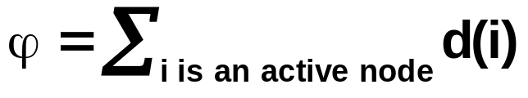
Correctness and Complexity (contd.)
THEOREM. The algorithm performs O(n²m) nonsaturating pushes.
PROOF. Let
The initial value of ϕ is at most 2n². If the distance label of a node increases by ε units, then ϕ too increases by ε units. The total increase over the entire algorithm is 2n².
Each saturating push increases ϕ by at most 2n units. The increase is at most 2n²m.
Each nonsaturating push decreases ϕ by at least one unit.
Hence the number of nonsaturating pushes is at most 2n² + 2n² + 2n²m = O(n²m).
THEOREM. The generic preflow-push algorithm runs in O(n²m) time.

Slide 42
Specific Implementations
FIFO PREFLOW-PUSH ALGORITHM:
Examine active nodes in the FIFO order. Keep active nodes in a queue.
This algorithm runs in O(n³) time.
HIGHEST-LABEL PREFLOW-PUSH ALGORITHM:
Always examine an active node with the highest distance label.
This algorithm also runs in O(n³) time.
Consider ϕ = max{d(i) : i is an active node}.

